Slide 1
Logic Circuits
...
Written by Rachel J. Morris, last updated 3/4/17

Slide 2
Chapter 3.5
This Chapter:
Using Boolean algebra with logic gates
Techniques to simplify circuits
Karnaugh maps

Slide 3
Data representation
Chapter 3.5 is about how Boolean algebra relates to computer circuits.
This is based on how computers store data as binary - 0's and 1's. This is true for representation of letters and numbers, as well as representing different kinds of commands that a computer can run.

Slide 4
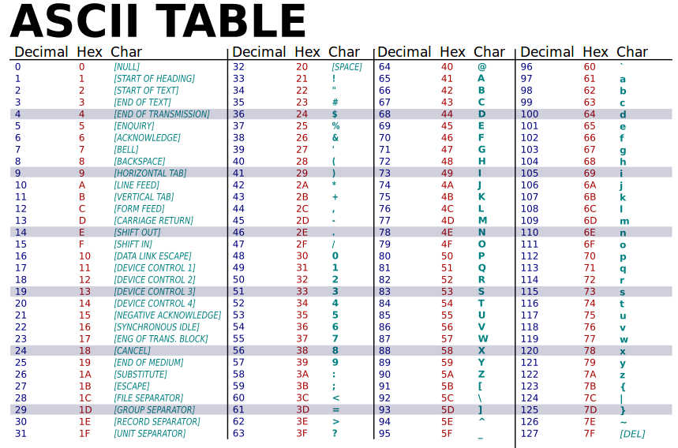
Data representation
Perhaps you've seen an ASCII table at some time:
From https://commons.wikimedia.org/wiki/File:ASCII-Table-wide.svg

Slide 5
Data representation
Perhaps you've seen an ASCII table at some time:
Notice that numbers are given as codes for letters, numbers, and even computer commands that don't have a graphical representation have codes.
‘A’ = 65
‘a’ = 97
Backspace = 9
These number codes are further translated into binary somewhere along the line.
‘A’ is 65, and in binary it is 0100 0001.
From https://commons.wikimedia.org/wiki/File:ASCII-Table-wide.svg

Slide 6
Data representation
Once we get into the Assembly level, the lowest level programming we can do (except for programming directly in binary), our binary representations look like this:
Addition MIPS Assembly code: ADD rd, rs, rt
Bitfields:
000000 | rs | rt | rd | 00000 | 100000
Subtraction MIPS Assembly code: SUB rd, rs, rt
Bitfields:
000000 | rs | rt | rd | 00000 | 100010
Branch if equal MIPS Assembly code: BEQ rs,rt,offset
Bitfields:
000100 | rs | rt | offset

Slide 7
Data representation
So when you write Assembly code,
it has a 1:1 translation to binary.
And with higher-level languages, one command may translate to several Assembly commands.
main:
# load values into "temp" registers
li $t0, 2 # $t0 = 2
li $t1, 5 # $t1 = 5
# add unsigned integers
addu $s0, $t0, $t1 # $s0 = $t0 + $t1
# display value of $s0
li $v0, 1 # prepare to output number
move $a0, $s0 # load parameter
syscall # display
Example MIPS assembly code

Slide 8
Data representation
So everything ends up boiling down to binary electric signals…
C program
Assembly program
Machine code
(Binary commands)
Electrical signals

Slide 9
Logic Gates

Slide 10



Logic gates
When designing circuits, some of the tools we have are logic gates to handle
and, or, and not.
AND
OR
NOT (negation)
Gate images:
https://en.wikipedia.org/wiki/AND_gate , https://en.wikipedia.org/wiki/OR_gate
https://en.wikipedia.org/wiki/Inverter_(logic_gate)

Slide 11
Logic gates
Using truth tables, we can see the results of
A · B, A + B, and A’
for some given inputs.
Now we use 0 and 1 instead of “T” and “F”.
AND
OR
NOT (negation)
A | B | A · B
0 | 0 | 0
0 | 1 | 0
1 | 0 | 0
1 | 1 | 1
A | B | A + B
0 | 0 | 0
0 | 1 | 1
1 | 0 | 1
1 | 1 | 1
A | A’
0 | 1
1 | 0
Gate images:
https://en.wikipedia.org/wiki/AND_gate , https://en.wikipedia.org/wiki/OR_gate
https://en.wikipedia.org/wiki/Inverter_(logic_gate)

Slide 12
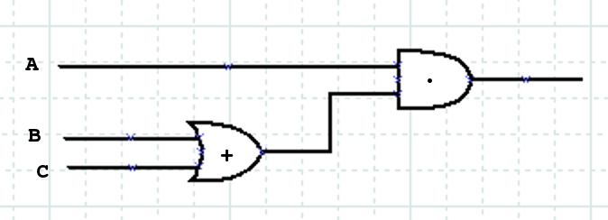
Logic gates
Example: Consider the following diagram. What is the Boolean algebra equation, and the truth table?
What does this final result symbolize?
Gate example from
http://www.cs.gordon.edu/local/courses/cps111/Notes/Boolean%20logic/boolgates.html

Slide 13
Logic gates
Example: Consider the following diagram. What is the Boolean algebra equation, and the truth table?
A·(B+C)
B+C
And what is the truth table for this diagram?

Slide 14
Logic gates
Example: Consider the following diagram. What is the Boolean algebra equation, and the truth table?
A | B | C | B+C | A·(B+C)
0 | 0 | 0 | 0 | 0
0 | 0 | 1 | 1 | 0
0 | 1 | 0 | 1 | 0
0 | 1 | 1 | 1 | 0
1 | 0 | 0 | 0 | 0
1 | 0 | 1 | 1 | 1
1 | 1 | 0 | 1 | 1
1 | 1 | 1 | 1 | 1

Slide 15
Boolean algebra properties
Just like with our logic and set properties, we also have similar properties for Boolean algebra:
(a) Commutative: a · b = b · a a + b = b + a
(b) Distributive: a · (b + c) = (a · b) + (a · c)
a + (b · c) = (a + b) · (a + c)
(c) Identity: a · 1 = a a + 0 = a
(d) Negation: a + a’ = 1 a · a’ = 0

Slide 16
Boolean algebra properties
Just like with our logic and set properties, we also have similar properties for Boolean algebra:
(a) Commutative: a · b = b · a a + b = b + a
(b) Distributive: a · (b + c) = (a · b) + (a · c)
a + (b · c) = (a + b) · (a + c)
(c) Identity: a · 1 = a a + 0 = a
(d) Negation: a + a’ = 1 a · a’ = 0
So it is possible for two gate diagrams to be logically equivalent, even if they’re designed differently.
Think of how this might affect the design of the physical hardware – we want the simplest design to save space and components.

Slide 17
Practice
Example 2 from the textbook
Show that
a + ( b · c ) = ( a + b ) · ( a + c )
with a truth table…

Slide 18
Practice
Example 2 from the textbook
Show that
a + ( b · c ) = ( a + b ) · ( a + c )
with a truth table…
a | b | c | b·c | a+b·c
0 | 0 | 0 | 0 | 0
0 | 0 | 1 | 0 | 0
0 | 1 | 0 | 0 | 0
1 | 0 | 0 | 0 | 1
1 | 0 | 1 | 0 | 1
1 | 1 | 0 | 0 | 1
1 | 1 | 1 | 1 | 1
a | b | c | a+b | a+c | (a+b)·(a+c)
0 | 0 | 0 | 0 | 0 | 0
0 | 0 | 1 | 0 | 1 | 0
0 | 1 | 0 | 1 | 0 | 0
0 | 1 | 1 | 1 | 1 | 1
1 | 0 | 0 | 1 | 1 | 1
1 | 0 | 1 | 1 | 1 | 1
1 | 1 | 0 | 1 | 1 | 1
1 | 1 | 1 | 1 | 1 | 1

Slide 19
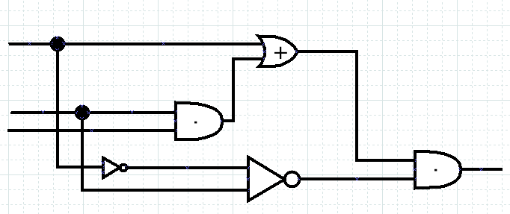
Practice
Practice problem 2 from the textbook
Write the Boolean expression for the circuit diagram, and simplify as much as you can.
a
b
c

Slide 20
Practice
Practice problem 2 from the textbook
Write the Boolean expression for the circuit diagram, and simplify as much as you can.
(a + bc)(a’b)’
= (a + bc)(a + b’)
= (a + (bc)b’
= a + cbb’
= a + c0
= a + 0
= a
a
b
c

Slide 21
Karnaugh Maps

Slide 22
K-maps: Two variables
Karnaugh maps are used to simplify boolean expressions. Instead of using a truth table, we draw our expression in a grid. We display all possible terms, and simplify.
y
y’
x
x’

Slide 23
K-maps: Two variables
Example: Let’s look at xy + xy’
If we look at it, we can see that it says “x and y, or x and not y”, which we can
logically reduce on our own, but let’s use a map.

Slide 24
K-maps: Two variables
Example: Let’s look at xy + xy’
First, we mark the two products on our grid.
y
y’
x
✓
✓
x’

Slide 25
K-maps: Two variables
Example: Let’s look at xy + xy’
First, we mark the two products on our grid.
Then we draw a rectangle around adjacent blocks that have been ✓d off.
Rectangles are what
represent where we can
simplify.
y
y’
x
✓
✓
x’

Slide 26
K-maps: Two variables
Example: Let’s look at xy + xy’ = x
The rectangle contains all states in the “x” row, so the simplified version here is just x.
If we had multiple rectangles,
then our simplified form
would be the sum of
these rectangles.
y
y’
x
✓
✓
x’

Slide 27
K-maps: Two variables
Example: Let’s look at xy + xy’ = x
We can also verify this mathematically:
xy + xy’
= x(y + y’)
= x · 1
= x
y + y’ = 1
y
y’
x
✓
✓
x’

Slide 28
Practice
Example 6 from book: Simplify xy’ + x’y’ with a Karnaugh map.
y
y’
x
x’

Slide 29
Practice
Example 6 from book: Simplify xy + xy’ + x’y
with a Karnaugh map.
1. Place checkmarks
y
y’
x
✓
✓
x’
✓

Slide 30
Practice
Example 6 from book: Simplify xy + xy’ + x’y
with a Karnaugh map.
1. Place checkmarks
2. Region off adjacent checks
y
y’
x
✓
✓
x’
✓

Slide 31
Practice
Example 6 from book: Simplify xy + xy’ + x’y
with a Karnaugh map.
1. Place checkmarks
2. Region off adjacent checks
3. Result is the sum of
these regions
(based on row/col
that is filled in)
x + y
y
y’
x
✓
✓
x’
✓

Slide 32
No simplification
Sometimes when you build a map, there is just no simplification, such as with this grid.
There are no adjacent
blocks with ✓ marks,
so it cannot be simplified.
y
y’
x
✓
x’
✓

Slide 33
K-maps: Three variables
What about when we have three variables? Then we build our Karnaugh map grid as it is below.
For the columns, labels in each column that are next to each other differ by only one variable – in other words, you can’t go
from yz to y’z’
in neighbors.
yz
yz’
y’z’
y’z
x
x’

Slide 34
Simplification guidelines
There are also additional guidelines for us to find the simplest expression with a Karnaugh map. There are different ways to find rectangles, but they’re not necessarily the most simplified forms.
yz
yz’
y’z’
y’z
x
✓
✓
x’
✓
✓
yz
yz’
y’z’
y’z
x
✓
✓
yz
yz’
y’z’
y’z
yz
yz’
y’z’
y’z
✓
✓
x
✓
✓
x
✓
✓
x’
✓
✓
x’
✓
✓
x’

Slide 35
Wrapping around
For these maps, our rectangles can also WRAP AROUND.
yz
yz’
y’z’
y’z
x
x’
✓
✓

Slide 36
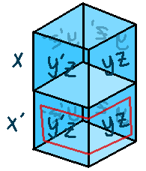
Wrapping around
yz and y’z are only one tiny difference apart, so perhaps it might be useful to think of the map as a 3D shape instead, which keeps looping.
yz
yz’
y’z’
y’z
x
x’
✓
✓

Slide 37
Smallest # of rectangles
Choose rectangles in a way that yields the smallest number of total rectangles, and that each rectangle is as large as possible.
yz
yz’
y’z’
y’z
x
✓
✓
✓
x’
✓
✓

Slide 38
Size 3 not allowed
Lengths of size 3 are not allowed: only length 1, 2, or 4.
(If it were size 3, you wouldn’t have full coverage of a row. 1 is allowed because it would be anything left over.)
yz
yz’
y’z’
y’z
x
✓
✓
✓
x’
✓
✓

Slide 39
Missing variables
If the equation has a term without one of the variables, then realize that the expression is true for both “true” and “false” for that missing variable.
xy means xyz and xyz’.
yz
yz’
y’z’
y’z
x
✓
✓
x’
Karnaugh map for xy

Slide 40
Examples
Examples
xyz + xyz’ + xy’z’ + xy’z
= x
The full row for x is filled in with ✓ marks, meaning that x is the only variable that actually affects the outcome of the equation.
yz
yz’
y’z’
y’z
x
✓
✓
✓
✓
x’

Slide 41
Examples
Examples
xyz’ + xy’z’ + x’yz’ + xy’z’
= z’
Notice that the two columns that are “full” are the ones that belong to z’.
z’ is always present, whether we have x, x’, y, or y’.
yz
yz’
y’z’
y’z
x
✓
✓
x’
✓
✓

Slide 42
Practice
Example 9 from the book: Simplify
xyz + xy’z’ + xy’z + x’yz + x’y’z
to the simplest form.
yz
yz’
y’z’
y’z
x
✓
✓
✓
x’
✓
✓

Slide 43
Practice
Example 9 from the book: Simplify
xyz + xy’z’ + xy’z + x’yz + x’y’z
to the simplest form.
Here’s the map…
yz
yz’
y’z’
y’z
x
✓
✓
✓
x’
✓
✓

Slide 44
Practice
Example 9 from the book: Simplify
xyz + xy’z’ + xy’z + x’yz + x’y’z
to the simplest form.
Here’s the map…
Result is
z + xy’
yz
yz’
y’z’
y’z
x
✓
✓
✓
x’
✓
✓

Slide 45

K-maps: Four variables
“Are we done yet?!”
Not yet… we can also work with maps of four variables.
“...dang.”

Slide 46

K-maps: Four variables
zw
zw’
z’w’
z’w
xy
xy’
x’y’
x’y

Slide 47
K-maps: Four variables
zw
zw’
z’w’
z’w
xy
Aren’t you exited?
Well, anyway…
xy’
x’y’
x’y

Slide 48
K-maps: Four variables
Keep in mind with these maps, now for columns and rows both, labels that are next to each other differ only by one.
And again, we can have wrap-around, but this time in both directions.
zw
zw’
z’w’
z’w
xy
xy’
x’y’
x’y

Slide 49
K-maps: Four variables
Example 10 from the book: Simplify
xyz’w’ + xy’z’w’ + xy’z’w + x’y’z’w’ + x’yz’w’
zw
zw’
z’w’
z’w
xy
xy’
x’y’
x’y

Slide 50
K-maps: Four variables
Example 10 from the book: Simplify
xyz’w’ + xy’z’w’ + xy’z’w + x’y’z’w’ + x’yz’w’
zw
zw’
z’w’
z’w
Map…
xy
✓
xy’
✓
✓
x’y’
✓
x’y
✓

Slide 51
K-maps: Four variables
Example 10 from the book: Simplify
xyz’w’ + xy’z’w’ + xy’z’w + x’y’z’w’ + x’yz’w’
zw
zw’
z’w’
z’w
Map…
Regions…
xy
✓
xy’
✓
✓
x’y’
✓
x’y
✓

Slide 52
K-maps: Four variables
Example 10 from the book: Simplify
xyz’w’ + xy’z’w’ + xy’z’w + x’y’z’w’ + x’yz’w’
zw
zw’
z’w’
z’w
Map…
Regions…
= xy’z’ +
xy
✓
xy’
✓
✓
x’y’
✓
x’y
✓

Slide 53
K-maps: Four variables
Example 10 from the book: Simplify
xyz’w’ + xy’z’w’ + xy’z’w + x’y’z’w’ + x’yz’w’
zw
zw’
z’w’
z’w
Map…
Regions…
= xy’z’ + z’w’
xy
✓
xy’
✓
✓
x’y’
✓
x’y
✓

Slide 54
K-maps: Four variables
Example 10 from the book: Simplify
xyz’w’ + xy’z’w’ + xy’z’w + x’y’z’w’ + x’yz’w’
zw
zw’
z’w’
z’w
Map…
Regions…
= xy’z’ + z’w’
Got it?
xy
✓
xy’
✓
✓
x’y’
✓
x’y
✓

Slide 55
Practice
Example 12 from the book: Build the simplest regions for this map.
zw
zw’
z’w’
z’w
xy
✓
✓
xy’
✓
✓
x’y’
x’y
✓
✓

Slide 56
Practice
Example 12 from the book: Build the simplest regions for this map.
Don’t forget
about being able to wrap around in all directions!
zw
zw’
z’w’
z’w
xy
✓
✓
xy’
✓
✓
x’y’
x’y
✓
✓

Slide 57
Practice
Example 13 from the book: Simplify
y’w’ + yz + x’yw’
zw
zw’
z’w’
z’w
xy
xy’
x’y’
x’y

Slide 58
Practice
Example 13 from the book: Simplify
y’w’ + yz + x’yw’
Remember that when variables are missing, we add them in as both the normal and prime forms.
y’w’ =
(xz)y’w’ or (x’z)y’w’
or (x’z’)y’w’ or (xz’)y’w’…
zw
zw’
z’w’
z’w
xy
✓
✓
xy’
✓
✓
x’y’
✓
✓
x’y
✓
✓
✓

Slide 59
Practice
Example 13 from the book: Simplify
y’w’ + yz + x’yw’
So the simplest form is
y’w’ + yz + x’w’
(tried to use circles to make it easier to see the overlapped regions)
zw
zw’
z’w’
z’w
xy
✓
✓
xy’
✓
✓
x’y’
✓
✓
x’y
✓
✓
✓

Slide 60


Alright, we’re done now.

Slide 61
yz
yz’
y’z’
y’z
x
✓
✓
x’z + xz’
x’
✓
✓
x’y + x’z + y’z
yz’ + y’z + x’z’ + x’y’
yz
yz’
y’z’
y’z
yz
yz’
y’z’
y’z
x
✓
x
✓
✓
x’
✓
✓
✓
x’
✓
✓
✓
yz
yz’
y’z’
y’z
x
✓
✓
x’
✓
✓
✓

Slide 62
yz
yz’
y’z’
y’z
x
x’
y
y’
x
✓
✓
x’
✓
yz
yz’
y’z’
y’z
x
y
y’
x
✓
x’
x’
✓
✓
yz
yz’
y’z’
y’z
x
x’

Slide 63
zw
zw’
z’w’
z’w
xy
✓
✓
xy’
x’y’
✓
✓
✓
✓
x’y
✓
✓
✓
✓

